Slide 1
Statistics week 4

Slide 2
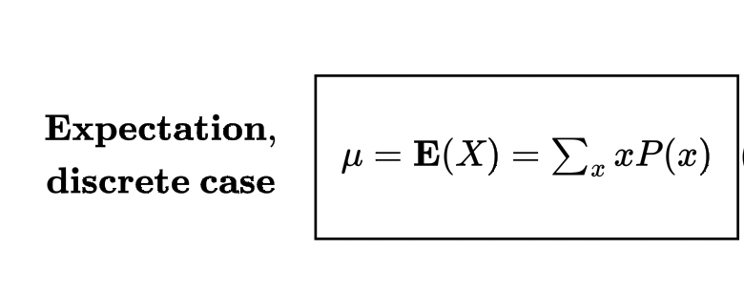
Expected Value
Expectation or expected value of a random variable X is its mean, the average value.
We know that X can take different values with different probabilities. For this reason, its average value is not just the average of all its values. Rather, it is a weighted average.

Slide 3
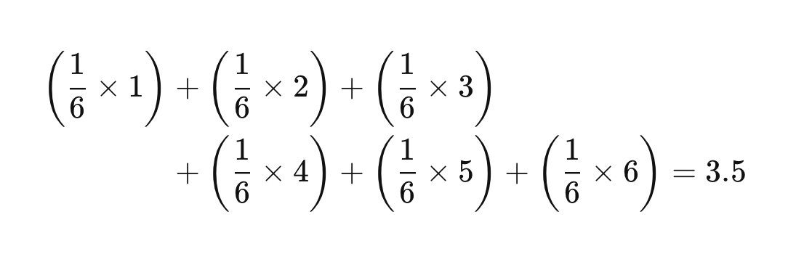
Example-Expected value
If you roll a 6 sided die , each side has a probability of 1/6 for landing.
The Expected value is given as:

Slide 4

Expectation of function

Slide 5
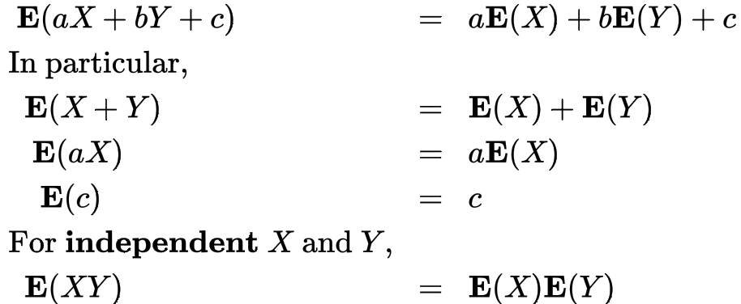
Properties of Expectation

Slide 6
Interquartile Range
Outliers are values that are abnormally different and away from the observed values.
An outlier can be because of an error, variability in measurement or can sometimes represent a new phenomenon.
If an extreme observation (an outlier) erroneously appears in our data set, it can rather significantly affect the values of mean and standard deviation.
In practice, outliers may be a real problem that is hard to avoid. To detect and identify outliers, we need measures of variability that are not very sensitive to them.
One such measure is interquartile range.

Slide 7
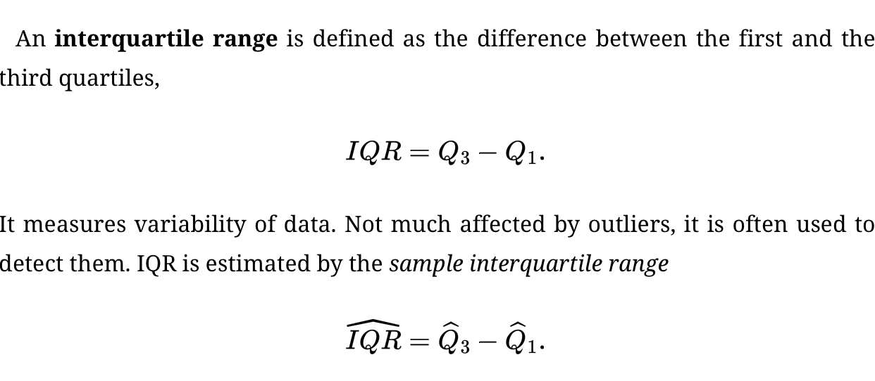
Interquartile Range

Slide 8
Interquartile Range
A “rule of thumb” for identifying outliers is the rule of 1.5(IQR). Measure 1.5(Qˆ3-Qˆ1) down from the first quartile and up from the third quartile. All the data points observed outside of this interval are assumed suspiciously far. They are the first candidates to be handled as outliers.

Slide 9
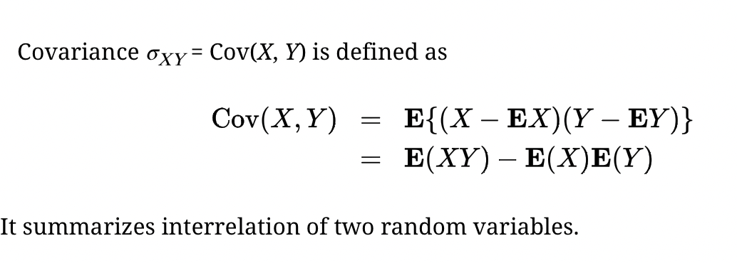
Covariance
Covariance is a way of measuring the relationship or association of 2 random variables.

Slide 10
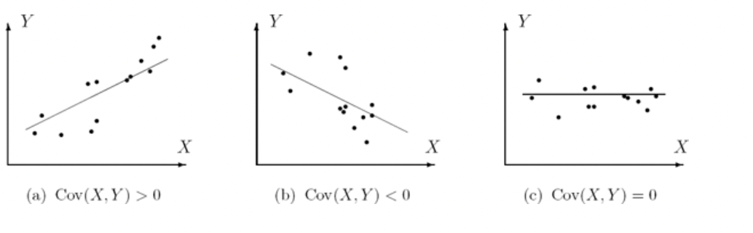
Positive, negative and zero Covariance

Slide 11
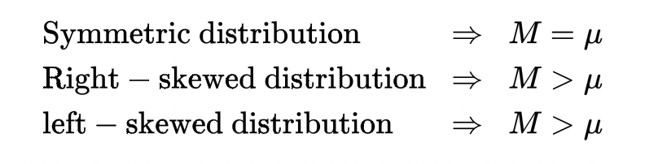
Skewness
It is the degree of asymmetry in any probability distribution.
A normal distribution, bell curve, has 0 skewness.
Skewness shows the direction of outliers.
It also shows how condensed is the data on any particular side.
Comparing the mean μ and the median M, one can tell whether the distribution of X is right-skewed, left-skewed, or symmetric.

Slide 12
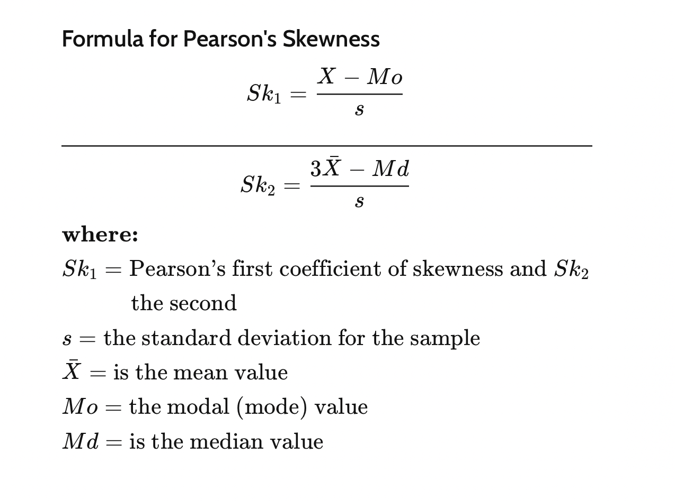
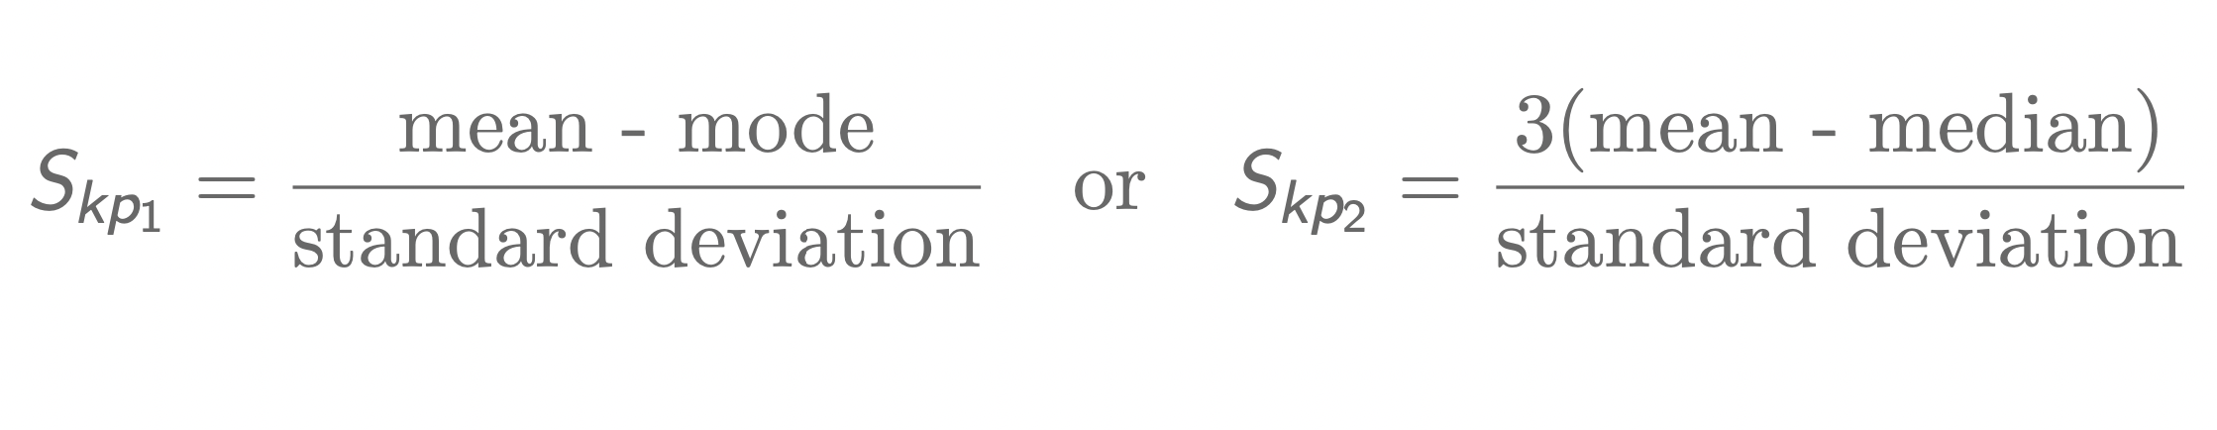
How to calculate Skewness

Slide 13
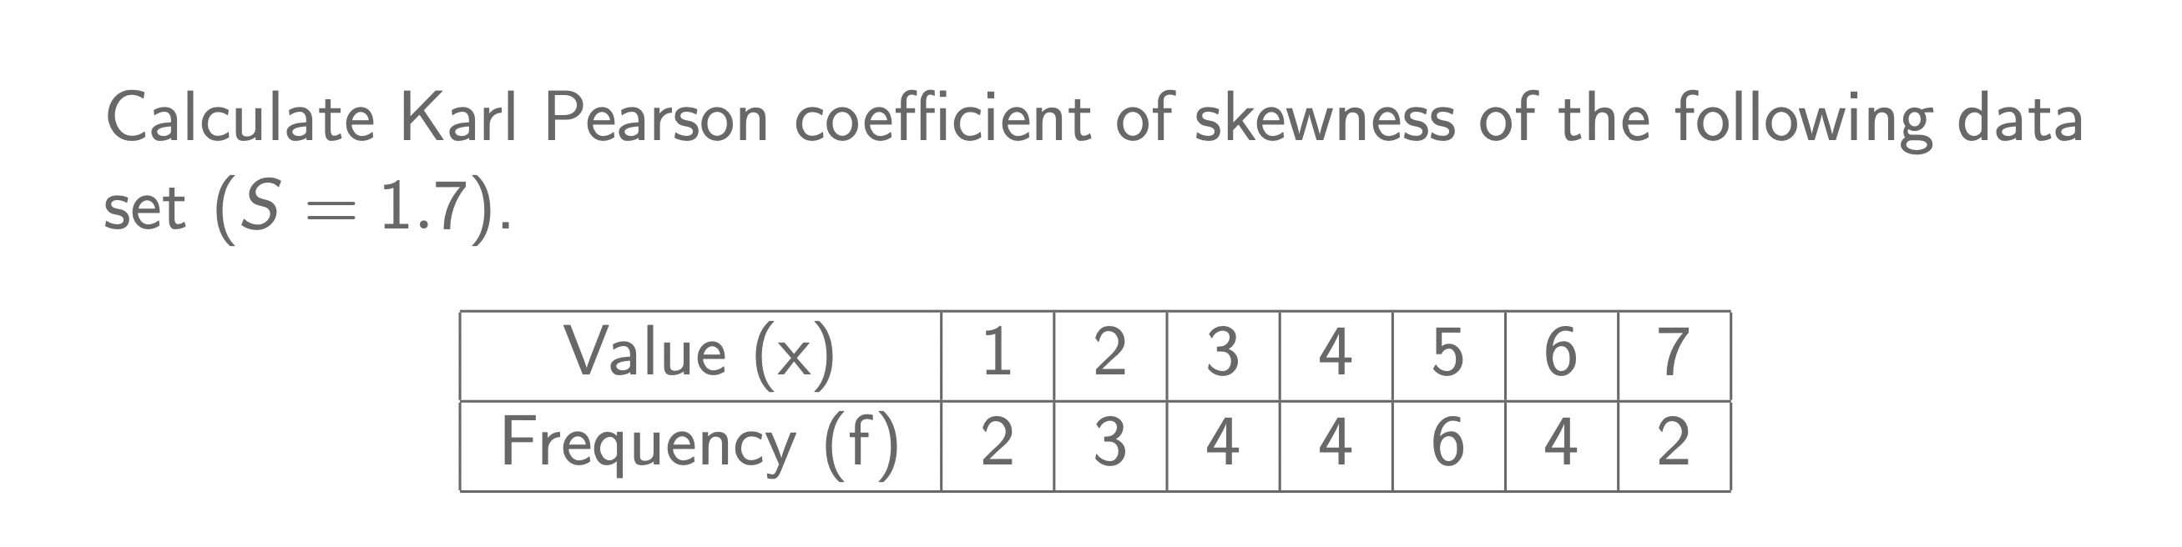
Example

Slide 14
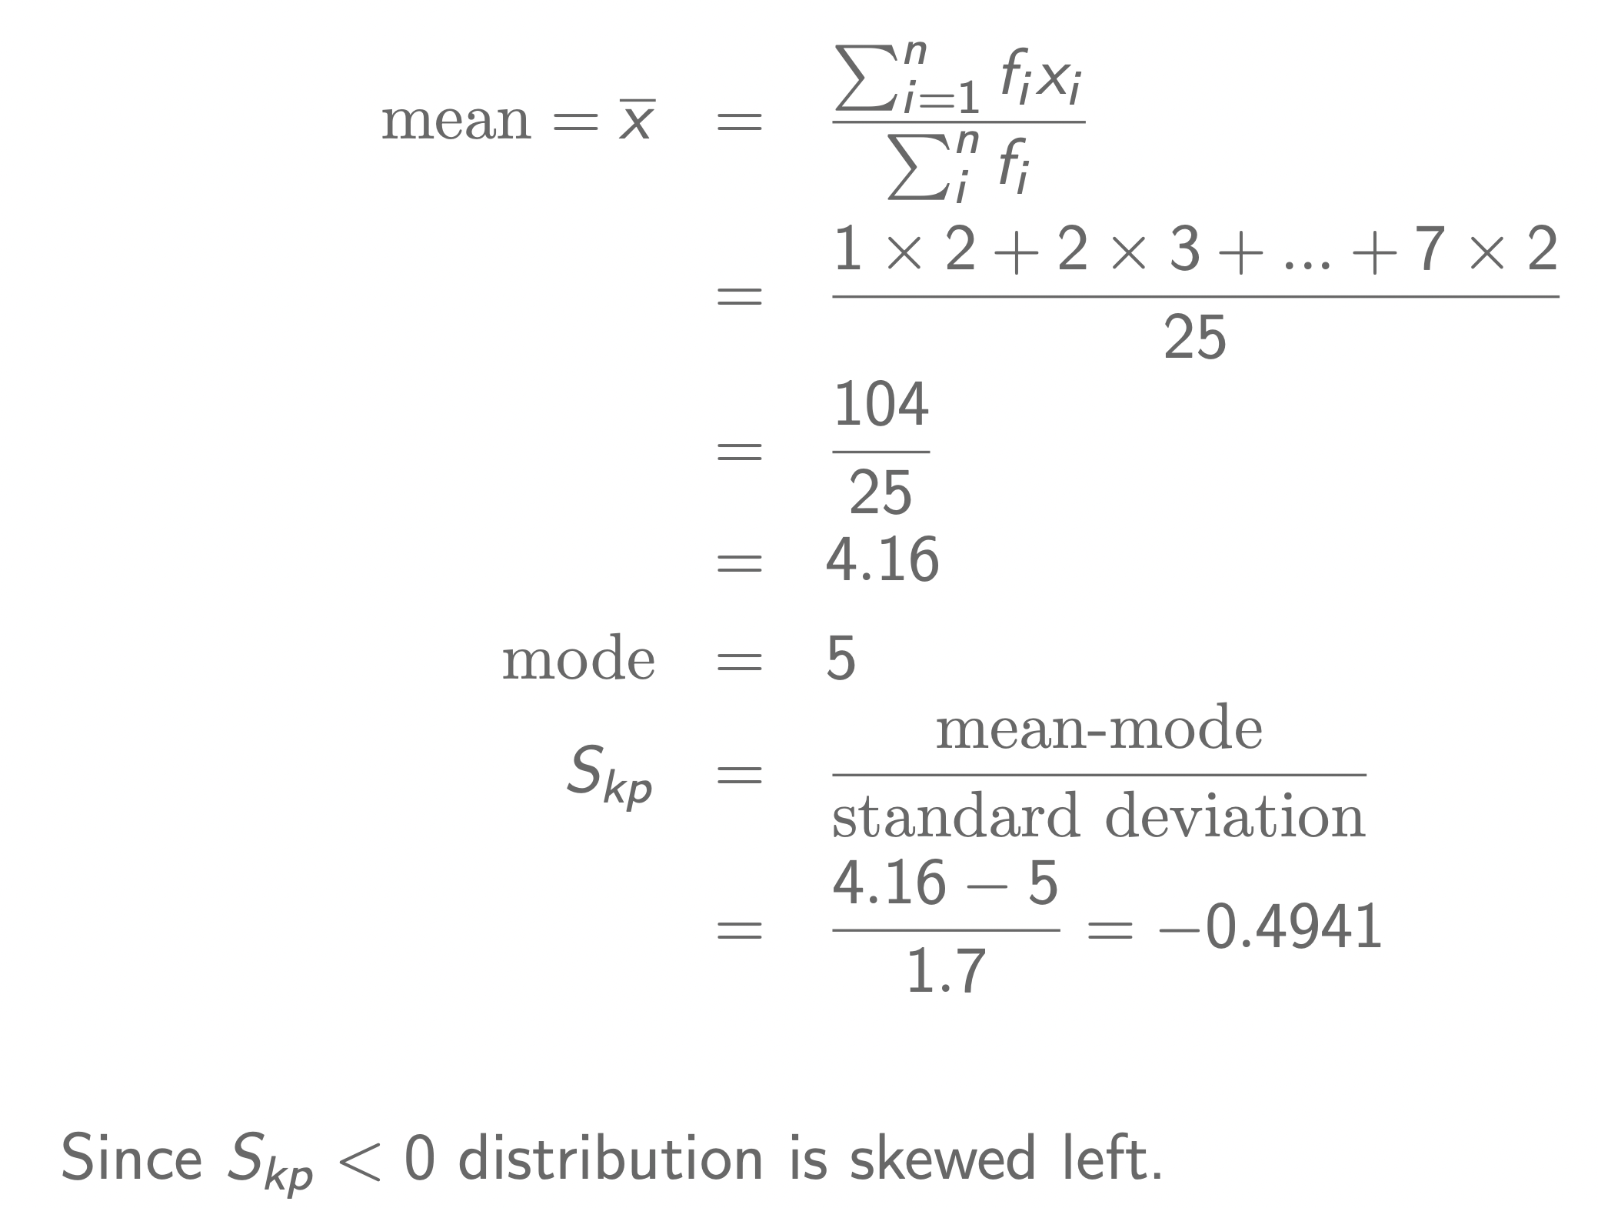
Solution

Slide 15
How to calculate skewness
−1≤Skp≤1.
Skp = 0 ⇒ distribution is symmetrical about mean.
3 Skp > 0 ⇒ distribution is skewed to the right.
4 Skp < 0 ⇒ distribution is skewed to the left.

Slide 16
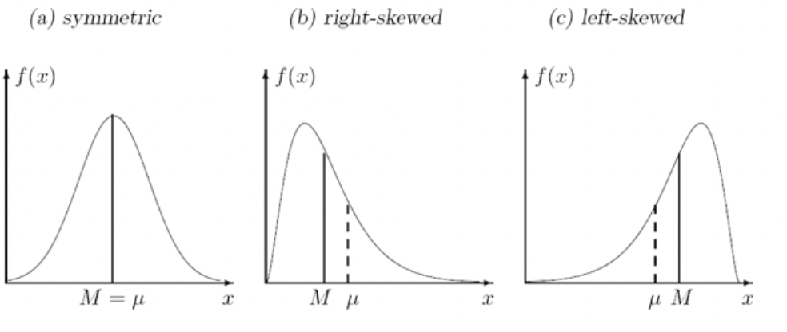
Skewness

Slide 17
Kurtosis
Kurtosis is a measure what extent any distribution has outliers.
It involves looking for extreme values in the tails.
There are 3 types of Kurtosis:
Leptokurtic
Platykurtic
Mesokurtic
All three types are relative to the normal distribution.
A higher kurtosis value means that there are more outliers which fall away from the mean.

Slide 18
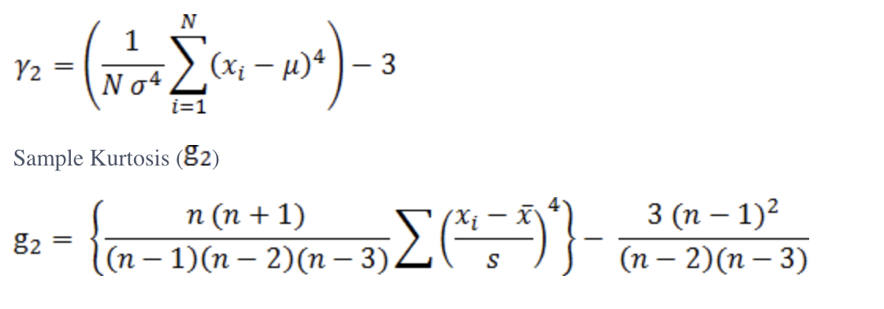
Kurtosis
It is also a measure of the sharpness of the peak.
A value greater than 0 indicates a peaked distribution and a value less than 0 indicates a flat distribution.

Slide 19
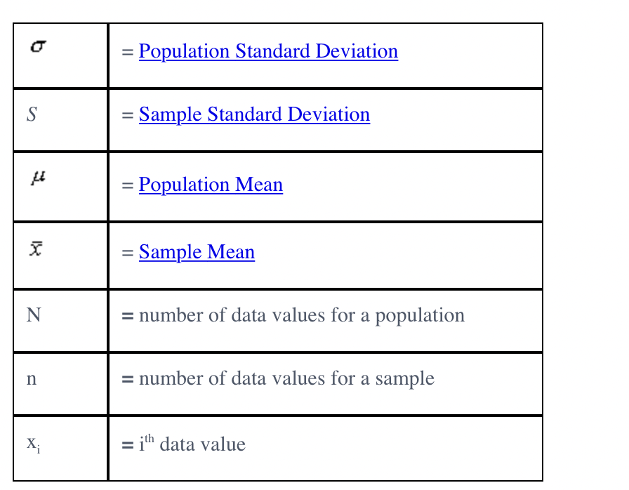

Slide 20
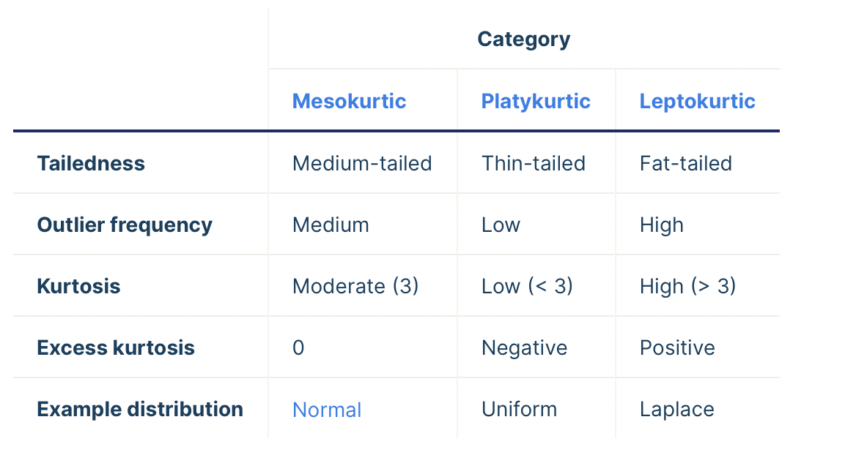

Slide 21
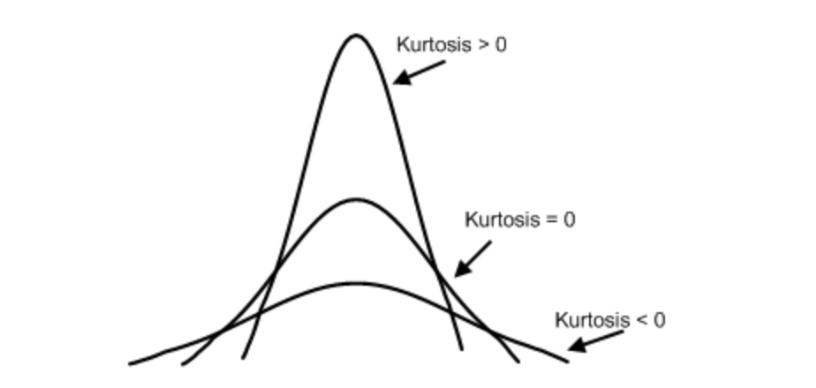

Slide 22
Monte Carlo Method
Predictive Approach
Probability Distribution
Repetitive simulations
Based on computer simulations involving random numbers
The main purpose of simulations is estimating such quantities whose direct computation is complicated, risky, consuming, expensive, or impossible.

Slide 23
Monte Carlo Methods
Monte Carlo methods are mostly used for the computation of probabilities, expected values, and other distribution characteristic.
“A Monte Carlo simulation requires assigning multiple values to an uncertain variable to achieve multiple results and then averaging the results to obtain an estimate.”
Its applications include:
Physical sciences
Engineering
Climate change
Computational biology
Computer graphics
Artificial intelligence
Gaming
Design and visuals
Finance
Law

Slide 24
Components of a Monte Carlo Simulation
Input variables
Output variables
Mathematical Model

Slide 25
Steps in Monte Carlo Methods
Establish the mathematical model
Determine the input values
Create a sample dataset
Set up the Monte Carlo simulation software
Analyze the results

Slide 26
Challenges of the Monte Carlo Simulations
Choosing the right input and probability distribution
Needs excessive computational power to run the experiment.

Slide 27
Any Questions?

